Slide 1
Book My Cinema
System Design

Slide 2
Requirement
Functional requirement :-
user can search movies based on city, theatre, movie and vice versa
user can select the theatre and reserve the seats.
user can do payment and place the order
user can cancel the ticket
public API :-
/search
user can search based on city or theatre or movie, methods can be as
below
getTheatreByMovie
getMovieByTheatre

Slide 3
Requirement
Functional requirement :-
/reserve
user can select the seat and app will show the pricing details,
method can be as below
reserveSeat
/payment
User do the payment - initiatePayment
/cancel
user can cancel the ticket

Slide 4
Requirement
Non-functional requirement :-
Scalability
Fault tolerant
Availability
Latency
Database Strategy -
Master-master replication
Federation or sharding

Slide 5
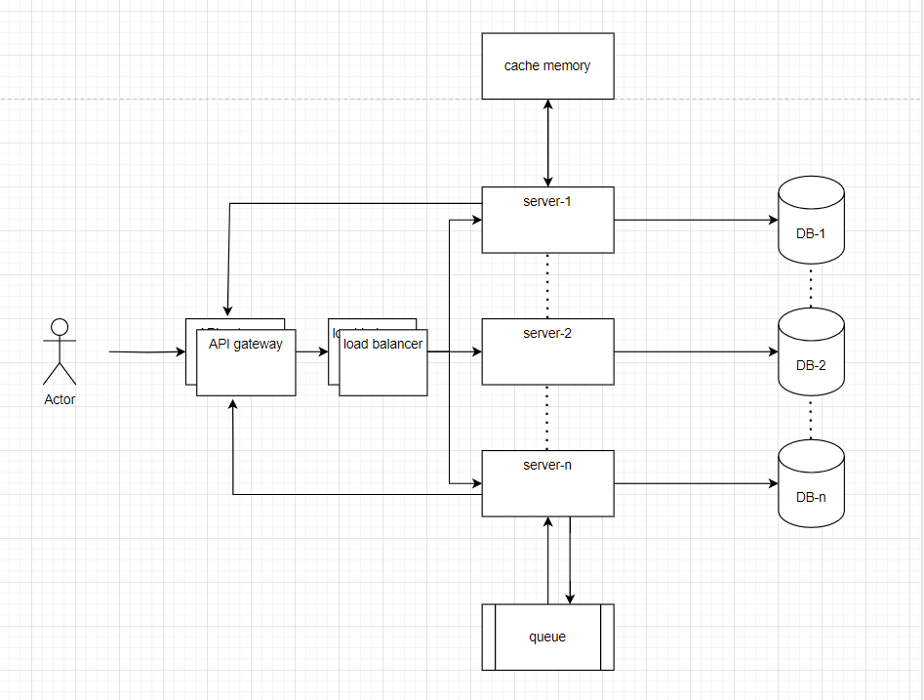
High Level Architecture

Slide 6
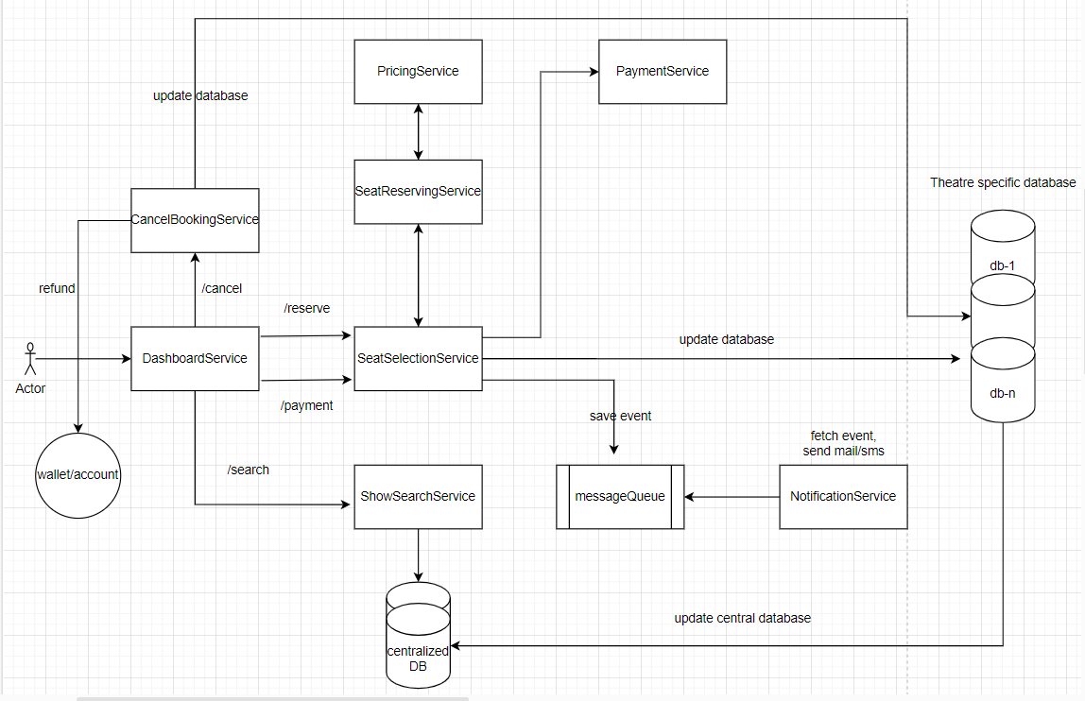
Low Level Architecture

Slide 7
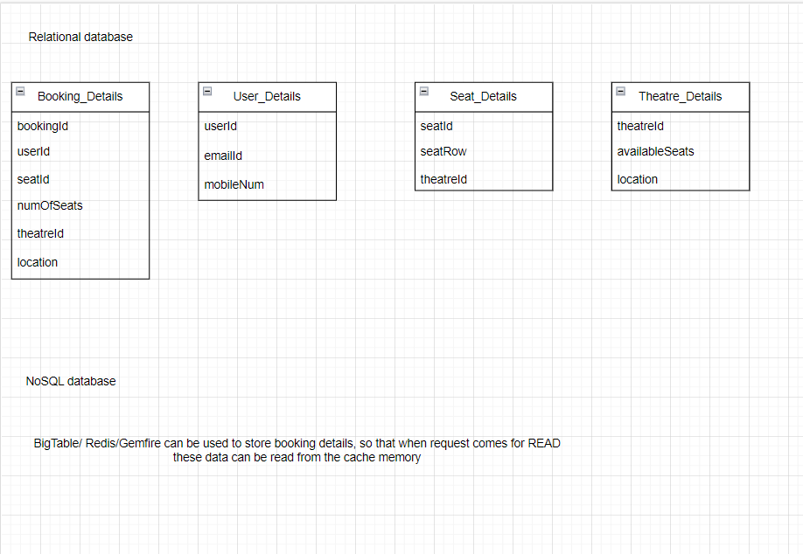
Initial Database Design

